Slide 1
Undergrad Advising Table Talk Series
Degree Audit Updates
Kristen Hargis, Degree Auditor
Lina Anastasio, Functional Specialist
Laura Mlyniec-Beam, Assistant Registrar – Degree Audit
degreeaudit@uconn.edu
January 16, 2025

Slide 2
Degree Audit Spring 2025 Contacts
Degree Audit | Cohort
Laura Albrecht | Undergraduate students with last names A-F
Sandra Cyr | Masters & Certificate Programs students
Kristen Hargis | Undergraduate students with last names Q-Z
Jenn Horan | PhD students
Liz Laskarzewski | Undergraduate students with last names K-P
Laura Mlyniec-Beam | Undergraduate students with last names G-J and all Ratcliffe Hicks and PharmD
degreeaudit@uconn.edu

Slide 3
Student Communications from Degree Audit
Communication | Purpose | Format | Frequency
Audit Ok | 1st audit good for application for graduation | Email; Automated from Student Admin | Nightly during term for students
Missing Plan of Study | Final plan of study is not submitted or pending approval | Email, automated from Student Admin | 3-4 times semester
Missing Requirements | Missing requirement that prevents graduation | Email, direct to student from auditor | 1-2 times per semester
In-progress courses: I/X/N or OFFC | An in-progress grade is affecting the degree audit negatively | Email, normally sent through Nexus | 2-3 times per semester
Credit Restrictions | Student is enrolled in a course that is credit restricted | Email, normally sent from DegreeAudit@uconn.edu | Before start of term; 1-2 times during term
Degree Awarded | Degree finalized/processed | Email, automated from Student Admin | Nightly post-final grades due/graduation date
Diplomas shipped & Certified electronic Diplomas (CeD) | Diplomas are in the mail a& CeDs can be purchase | Email, sent from vendor | Approx. 6-7 weeks after conferral date

Slide 4
Spring 2025 Updates
Updating PDF Versions of Advisement Reports: Course History Table
- ADA accessibility
- Rows with alternative gray lines
- Clearer columns for P/F, etc.
- Moved “Repeat Codes” to far-right column (previously under the course title)
GOAL: Common Curriculum Advisement Reports *LIVE*
Scheduling and Curriculum Updates
- CAR & GPAR Systems being retired: https://changecatalog.uconn.edu/
- New proposal submissions deadline Feb. 1, 2025

Slide 5
Common Curriculum for Leadership and Global Citizenship
Common Curriculum for Leadership and Global Citizenship
Registrars staff is working with CCC+ Committees
New Advisement Reports are in the development phase
Communications Plan
Internal Registrar business practice changes
Common Curriculum’s FAQs
Students: https://commoncurriculum.senate.uconn.edu/faqs/faq-for-students/
Advisors: https://commoncurriculum.senate.uconn.edu/faqs/faqs-for-advisors/

Slide 6
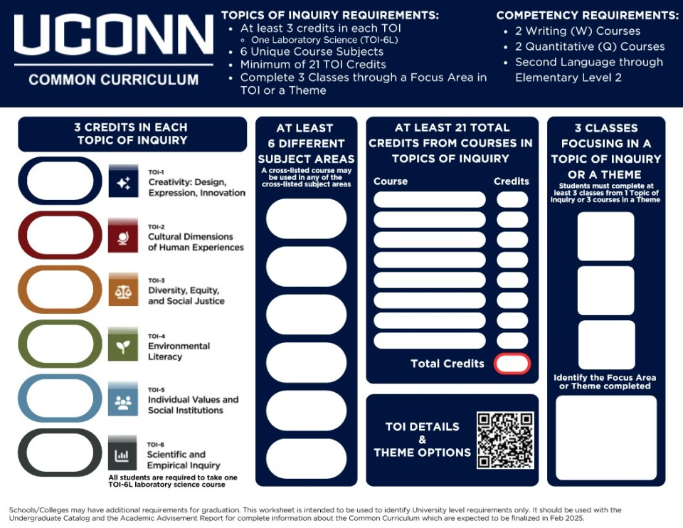

Slide 7
Summer 2025 and Beyond
Advisement Report Text Changes
CIM Goes Live
- CAR & GPAR Replacement

Slide 8
Questions?
degreeaudit@uconn.edu

